Slide 1
Domain #4 Capstone Project Healthcare claim analytics - denial Claim Prediction
Group 16
Sanjib J Patra 2018AIML550
Parveen Kumar 2018AIML560
NVS Anil Kumar 2018AIML635
Sameer K Vaishampayan 2018AIML576

Slide 2
Acknowledgements
Thanking our Mentor, Faculty and TA for their Guidance and Help
Lead Instructor Name: Prof. Gautam Gangopadhyay
Lead Faculty: Prof. Kamlesh Tiwari
Faculty: Prof. Raja Vadhana P
Teaching Assistant Name: Kartheek Akella

Slide 3
Table of Contents
Problem statement
Objective
Background of previous work done in the chosen area
Machine Learning Process Flow
Potential Data Challenges & Risks
Detailed Plan of Work
Pre-Processing
Machine Learning Modelling & Techniques Applied
Interpretation
Future Work & Extension or Scope of improvements
Conclusions / Recommendations

Slide 4
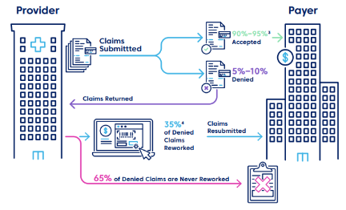
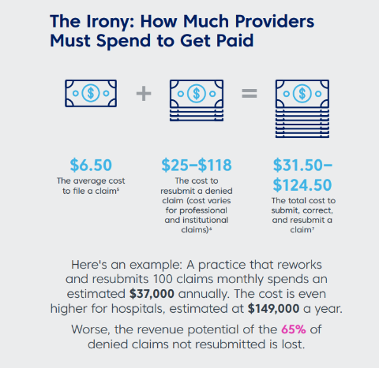
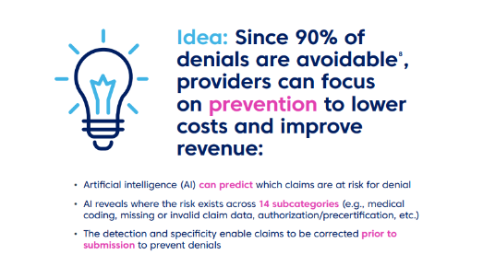
Problem Statement
Can AIML help the healthcare industry to lessen their losses due to lapses, help administrators optimize their process and help improve revenue?
Denial and rejection of healthcare claims is a significant administrative burden and represents hundreds of billions of dollars in lost revenue for healthcare organizations each year.
Ability to Predict Status of Medical Claim by analyzing the parameters like approval status, diagnosis status and bundled service status can help industry with Denial Propensity scoring and Denial Prevention
According to a study* On an average 5%-10% claims are denied and 65% of these are never resubmitted
* https://www.changehealthcare.com/insights/ai-powered-claim-denial-prevention

Slide 5
Objective
Background
Healthcare claim practices across world are in the Business of Accelerating the Reimbursement Cycle of Providers
An estimated $262 Billion, or 9 percent, of the estimated $3 Trillion in claims submitted by hospitals are initially denied.
63 percent of denied claims are recoverable on average, but providers spend as much as $8.6 Billion administrative costs nationwide.
An average 350-bed hospital misses $22 Million in revenue capture opportunities.
Objective
While the rules are well defined in the contract in-terms of what is covered and what is not but in-practice when filing for the claim it is difficult to know in-advance if all the necessary documentation and other procedures are followed as per the contract to recover the cost and get full payment for the claim.
Use of Machine Learning (ML) to predict denials and take corrective measures before-the-fact and help improve following Key Performance Indicators (KPI):
Lowering potential Denials of the Providers
Improving Provider Reimbursements

Slide 6
Medical Claims Process
Assisting all players/ stakeholders across the Health Claims Value Chain
Policy Holder
Avails a Medical Service
Deductibles
Provider
Medical Services Records
Medical Billers and Coders
Insurance Details
Medical Services Costs
Payer
These are the cases we try to predict and minimize
Accept and Pay in Full
Medical Claims/ Bills
Deny and Return for Correction
Reject

Slide 7
Business Benefits
Modern healthcare service records, called Claims, record the medical treatments by a Provider (Doctor/Clinic), medication advised etc., along with the charges, and payments to be made by the patient and the Payer (insurance provider). Denial and rejection of healthcare claims is a significant administrative burden and represent hundreds of billions of dollars in lost revenue for healthcare organizations each year. Prediction of Claims prone to denial is critical to lowering this burden of rework. This process provides denial reduction and insights to increase claim acceptance rates for future claims.
Provider Perspective
Improve Reimbursements
Manage Denials Effectively
Reduce Revenue Cycle Costs
Meet Required Quality Standards
Payer Perspective
Improve Turnaround of Claims
Reduce Operations Costs

Slide 8
Previous Work
Domain studies on potential parameters and processes that might be causing claims to be denied
Several of these studies highlight various factors that influence claim denial/rejection
They also highlight shortcomings of rule based analytical approaches to solution
Studies around data preparation that are typical to this problem, for example, imbalanced class in data
Several Studies show how class imbalance characteristic of this kind of problem can be handled
Several Studies show how significant features can be identified to reduce dimensions
Several Studies show how to handle datasets where there are too many categorical attributes with many non-unique values characteristic of this kind of problem
Studies around ML models that are best suited for data typical to this problem, for example, models that work best with imbalanced data, more and more categorical values than numerical values
Several studies point out methods that can be more suitable for such kind of problems, e.g., Catboost which is specifically geared towards categorical features.
Several Studies compare various methods as applied to these problems
Several studies talk about modern tools like driverless AI of H2O, artificial neural networks that can be applied to get optimal results.

Slide 9

Understanding of Machine Learning( Pipeline)
Extracting Knowledge hidden in large volumes of data
Identifying potentially useful and understandable data - Which data set will give hidden pattern
KDD – Knowledge Discovery in Database/Dataset
Target
Connectedness
Wisdom
Prescriptive
Analysis
What Should be done
KDD Analysis
Understanding
Principles
Knowledge
KDD & Data Mining Analysis
Predictive
Analysis
What could happen
Understanding
Pattern
Information
KDD Analysis
Descriptive
Analysis
What has happened
Understanding
Relations
Data
Understanding
9

Slide 10
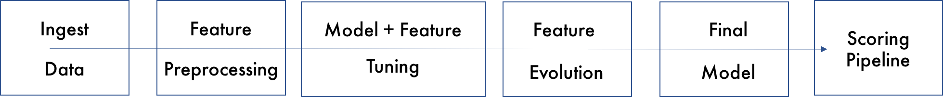
ML Steps
ML Steps
Apply Model
Monitoring
9
Data Preparation
Mode Refresh
Classify Claims
Business
Objectives
Model
Deployment
Drive Initiative
1
8
ML Objectives
7
Build Model
2
Build Model
Calculate Score
3
Data Availability
Validate Model
Data
Modeling
6
4
Data Cleansing
5
Data Transformation

Slide 11
Detailed Plan of work
Outlier- Identification, Visualization and handling
Correlation Visualization
Handling of Categorical values
Scale Dataset
SMOTE/SMOTENC/RUS/ROS
Visualizations
Apply Different Model
Model Tuning
Evaluation & Interpretation
Report Writing
Explain and Discuss the problem statement
Understanding of data structure
Upload data
Exploratory Data Analysis - Variable Identification, Visualization (plots)
Modeling :
XGBoost
CatBoost
lightGBM
SVM
Week 01
Week 03
Week 07
Week 05
Week 02
Week 04
Week 06
Week 08
Feature Engineering
Drop columns which are not required
Find, Visualize and Impute missing values
Reviews along with BITS Faculty
Modeling
Split data betweeen test and train
Running ML Models
Logistic Regression
Decision Tree
Random Forest
Reviews along with BITS Faculty
Apply Different model
Implementing GridSearch and Pipeline for Tuning above models
Artifical Neural Network
Implementing H2O
Reviews along with BITS Faculty
Model Tuning
Evaluation & Interpretation
Report Writing
Preparation & submission of Solution
Review of solution
Viva Voce

Slide 12
Project Resources
Sr No | Phase | Resource Type | Resource | Versions if Applicable
1 | All | People | Mentor, Faculty, TA
2 | All | Hardware | GPU runtime on Google Colab Google Drive
3 | All | Software | Jupyter Notebook Anaconda Python H2O Runtime CatBoost, Category Encoders Dask Imbalanced Learn LightGBM XGBoost Seaborn Driverless AI H2O.ai | python:3.6.9 [GCC 8.4.0] scipy:1.4.1 numpy:1.18.4 pandas:1.0.3 category-encoders:2.2.2 catboost-0.23.2 xgboost-0.90 lightgbm-2.2.3 ubuntu1~18.04.1. openjdk version "11.0.7" OpenJDK Runtime Environment (build 11.0.7+10-post-Ubuntu-2ubuntu218.04 colorama-0.4.3 h2o-3.30.0.3
4 | Collaboration | Software | Google Meet GitHub
5 | All | Laptops | 16GB RAM, Windows 10, Intel Core i7

Slide 13
Potential Data Challenges and Risks
Sr No | Data Challenge/Risk | Description | Mitigation
1 | Input history data size was huge (116 MB) | Due to very high size of historical data, our local machine had difficulties to pre and post process | This data challenge was mitigated using Google Colab for executing whole project
2 | Limited domain knowledge | Due to limited domain knowledge decision taken to keep/ drop/ process/ merge/ various attributes | This Risk was mitigated using inputs from Coordinator/ client.
3 | Imbalanced label | Distribution of Label was imbalanced. Accepted to Denial ratio was 99.6/ 0.4 | Techniques such as SMOTE, Random Over Sampler, Random Under Sampling are used
4 | Too many categories in features like Procedure code, Service Code, Diagnosis Code, Revenue Code | Too many categories in these fields and many blanks in procedure code. Treatments done on members do not require any procedure to be undertaken, but deleting the rows that have null values for the Procedure Code is not advisable as the Claims without Procedure Code do have Label of 0 and 1. | Project Sponsor provided the grouping rules and we applied them.
5 | Lot of Categorical Features | There are almost 10 categorical features in the dataset. | Applied methods like Catboost that are more suited to such dataset
6 | Numerical values has outliers and high variances | Numerical data consisting of amounts were in very high degree of range. | Drop outliers and keep range of values in a standard of range using techniques such as MinMax Scaler
7 | Garbage/ Bad Data | There are rows with blank Claim number, there are rows with denial reason codes specified against accepted claims, and there are rows with whitespaces in many columns. | Deleted rows with blank Claim Number Deleted duplicate claim number + Claim line number combination, Replaced whitespaces with Null value.

Slide 14
Preprocessing: Data Observations
Data is available in excel workbook that contains three tabs
Tab-1 (History Data) contains all attributes of the claims processed except Label
Tab-2 (Accept-Denial-Label) contains only Target variable (Label) of each row of Tab-1 data with one common attribute
Tab-3 contains all attribute list
Total records: 472559
Total columns: 21
3 columns are numeric type (continuous numeric value): ["Claim.Charge.Amount", "Subscriber.Payment.Amount", "Provider.Payment.Amount"]
10 columns are category type (discrete tag value): ["Revenue.Code", "Service.Code", "Procedure.Code", "Diagnosis.Code", "In.Out.Of.Network", "Claim.Type", "Claim.Subscriber.Type", "Claim.Current.Status", "Place.Of.Service.Code", "Denial.Reason.Code"]
7 ID type. columns are useless from significance perspective: ["srlno", "Claim.Number", "Claim.Line.Number", "Member.ID", "Provider.ID", "Network.ID", "Agreement.ID" ]

Slide 15
Preprocessing: Data Preparation
Observations and Actions:
The distribution of the data is skewed towards a few categories, while the other categories have very little representation.
The target variable Label has very skewed distribution of the of 99.3% and 0.6% wherein 99.6% is accepted claims and 0.6% is denial claims.
There are whitespaces in few of the attributes in many rows.
There are four Attributes – Revenue.Code, Service.Code, Procedure.Code, Diagnosis.Code that are categorical in nature but have too many non-unique values. Project sponsor has provided grouping rules for these fields.
Denial.Reason.Code is an attribute that is directly related to denials in label. Any rows that are accepted but has a denial reason code defined are bad data
Claim.Number and Claim.Line.Number together uniquely identify a claim. Any rows with duplicate combination of these two columns or blank in any of these fields are considered bad data
Claim.Charge.Amount attriubute has values in most of the rows but has a huge variation. Normalization using MinMaxScaler is done for this attribute. Also outliers are found and deleted.
Fields with more than 70% blank data or ID columns are deleted
Categorical attributes are BinaryEncoded.
Given that the dataset is skewed towards one of the Labels, if the model is to learn for both acceptance and denial, synthetic data smoothing techniques need to be used before building the model.

Slide 16
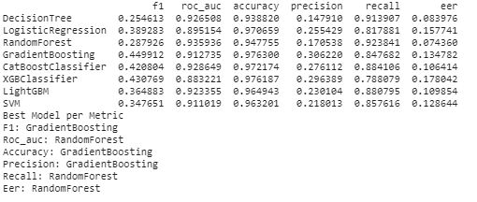
Machine Learning Modelling & Techniques Applied
Preparation
Scaled the dataset – MinMax Scaling is used
Applied SMOTE (Synthetic Minority Over-sampling Technique) to balance data
Used SMOTENC, ROS, RUS as alternates
Apply Models
Logistic Regression
Decision Tree
RandomForest
XGBoost
CatBoost
LightGBM
SVM
ANN
H2O AutoML
Find Model Summary
Sample Results with Random Under Sampling

Slide 17
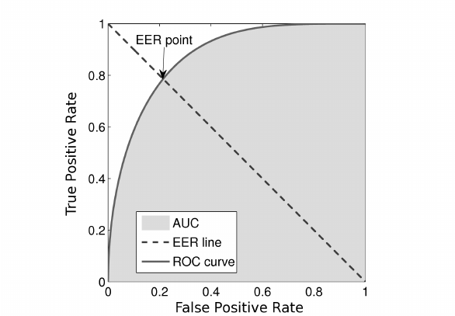
Metrics
Metrics Used to Evaluate
Confusion Matrix | Predicted Denied (Positive – Label: 1) | Predicted Accepted (Negative – Label: 0)
Actual Denied (Positive - Label: 1) | TP | FN
Actual Accepted (Positive - Label: 0) | FP | TN
Recall on 1 (denied) of 0.8 implies that there is 20% chance that a claim actually denied may be predicted as accepted
Precision on 1(denied) of 0.8 implies that there is 20% chance that a claim actually accepted may be predicted as denied.
So we chose F1 as the evaluation metrics
We also calculated Equal Error Rate as one of the metric
The idea of ROC EER is the intersection point between a straight line joining (1,0) and (0,1) and the roc Curve.

Slide 18
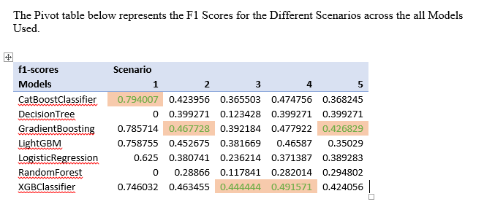
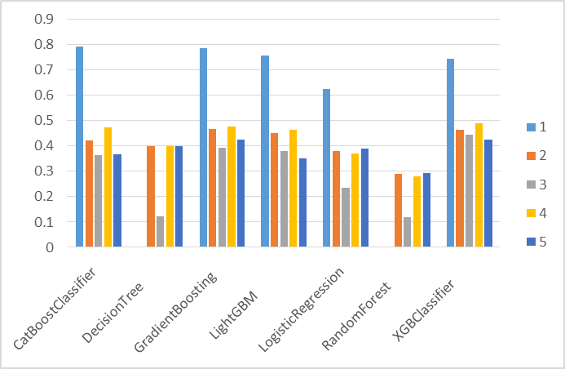
F1 Scores

Slide 19
Interpretation
Business Implication
The above assessment helps us conclude that leveraging the probability scores for the Claim Numbers that have been predicted as Denied the institution can strengthen the controls on the documentation and validate the Diagnosis procedures used for a particular claim and make corrections so that they can reduce the number of claim that will be denied even before submitting to the insurance providers.
This should results in significant saving from a revenue standpoint and also amplify the customer satisfaction scores for patients treated in their hospitals. Overall an early warning on the status of claims can help reduce losses and help improve the repute of the organization and achieve the target objective the business desired.

Slide 20
Conclusions / Recommendations
The project was successfully able to identify the machine learning model to classify the health claims appropriately as Accepted or Denied.
The F1 metric was chosen to select the final best model since it has ability to maximize both precision and recall. Our objective here is to minimize both False Negative and False Positive predictions while maximizing true predictions.
Equal Error Rate is a metrics that has been explored and aligns more or less to F1 trends. So we stick with F1 Score for final model evaluation.
The Catboost algorithm looks to be one of the better methods of the all the chosen evaluation models for this kind of dataset and problem.
Based on the selected model the output below depicts the predicted value as well as the confidence scores for each of the claims. The output has huge potential to both Payers and Providers in identifying potential denials before fact and take actions to avoid costly administrative impact or denied claims.
This study also brings forward the potential that H2O library brings for solving such problems.

Slide 21
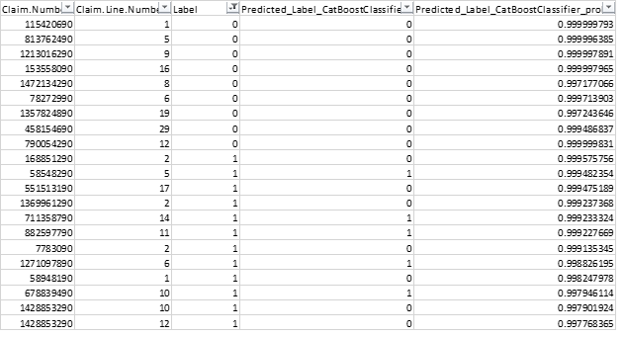
Conclusions / Recommendations
Sample Report

Slide 22
Future Work & Extension or Scope of improvements
The claim denial code field has lot of information which can help our model predict why a claim could be denied or rejected. Future study and analysis could include enriching our Label field with this information and do a multi-class learning and prediction. This can enable proactive adjustments to claims so that they get accepted in first iteration itself. When a potentially problematic claim is flagged, AI can conduct an analysis across various subcategories (indicated in denial reason code field) to identify the root cause.
Class imbalance is one big characteristic of this dataset. We can explore more different methods than just SMOTE/ROS/RUS to obtain better results.
We can look to carry out PCA analysis if time permits.
A more detailed hyper parameter tuning may be needed for more robust models.
We should also try to do binning for numerical columns as well(at-least for claim.charge.amount, as this a 5th important feature) at check impact on model performance.
From Machine Learning perspective, every three months we should retrain / revalidate models on new historical data.
We used Driverless AI for H2O for validation and results show that there is scope for future work on improving models. Some of the steps could include:
Improve methods for feature engineering
Explore Ensemble methods more to get more improved results
As evident our results tend to concur with driverless on that XGBoost came as best model

Slide 23
Thank You!
Lead Instructor Name: Prof. Gautam Gangopadhyay {gautam.g@wilp.bits-pilani.ac.in}
Teaching Assistant Name: Kartheek Akella {f20160015@hyderabad.bits-pilani.ac.in}
Faculty Name: Prof. Kamlesh Tiwari
Faculty Name: Prof. Raja Vadhana P
Sanjib Patra
Parveen Kumar
NVS Anil Kumar
Sameer K Vaishampayan

Slide 24
Preprocessing: Data Preparation
Denial.Reason.Code
We will consider following valid Denial.Reason.Code
F13, J8G, JO5, JB8, JE1, JC9, JF1, JF9, JG1, JPA and JES
Denial.Reason.Code
<Blank> 326030
F13 1068
J8G 382
JB8 128
JC9 49
JE1 33
JES 50
JF1 4
JF9 98
JG1 10
JO5 105
JPA 44
Name: Denial.Reason.Code, dtype: int64
Rows with label zero (0) without any Denial.Reason.Code (blank) should be kept

Slide 25
Preprocessing: Data Preparation
Revenue.Code
Clubbing of Category Value (1 ,2,3 – High , Medium , Low possibility group respectively)
High_Revenue_Code = ["810", "811", "124", "261", "260", "331", "914", "174", "634", "173", "682", "126", "128", "172", "127", "200", "821", "134", "302", "740", "249", "270", "771", "361", "310", "434"]
Medium_Revenue_Code= ["210", "275", "122", "610", "206", "258", "444", "278", "117", "259", "121", "112", "276", "731", "750", "460", "360", "271", "730", "307", "424", "370", "250", "410", "940", "305", "350", "921", "480", "111", "351", "920", "636", "309", "300", "390", "301", "450", "440", "306", "311", "324", "710", "341", "272", "343", "942", "171", "482", "420", "490", "483", "312", "481", "352", "510", "402", "320", "720", "762", "761", "430", "403"]
Rest Low

Slide 26
Preprocessing: Data Preparation
Service.Code
Clubbing of Category Value (1 ,2,3 – High , Medium , Low possibility group respectively)
High_Service_Code = ["UNI", "RL8Y", "RM8W", "DU7O", "IH7O", "RM8I", "RI7Y", "SB7W", "GB7A", "NI7I", "OVV", "RM9I", "RR8I", "IMY", "RT8I", "RY8W", "RY7I", "IC7I", "SU7A", "ER7I"]
Medium_Service_Code = ["TO7W", "TE7O", "CC7I", "HV7I", "MR7O", "IN7I", "AL7I", "DI7O", "CT8Y", "RB7W", "RV8W", "CT7I", "RB8I", "RK8Y", "RB7I", "OE7I", "RY8I", "OP7O", "LA7O", "NS7I", "CL7O", "MR7Y", "ER7O", "CT7Y", "CT7O", "RA7O", "MD7O", "TH7O"
Rest Low

Slide 27
Preprocessing: Data Preparation
Diagnosis.Code
Clubbing of Category Value (1 ,2,3 – High , Medium , Low possibility group respectively)
High_Diagnosis_Code = ["2929", "29690", "V202", "29663", "29622", "9962", "67524", "5193", "V045", "29530", "7999", "430", "29664", "5711", "79095", "30411", "29189", "6162", "29570", "29630", "29644", "5289", "20240", "99741", "37943", "9352", "V08", "V1255", "V5041", "80225", "6108", "57480", "5070", "V6284", "52460", "8024", "99681", "V3101"]
Medium_Diagnosis_Code = ["75249", "71100", "29660", "78722", "2273", "6868", "64844", "73671", "37730", "61804", "6146", "V5831", "2989", "7503", "72992", "29181", "2452", "80841", "8250", "66111", "9950", "29640", "9220", "99563", "7222", "29650", "65811", "29632", "52403", "99676", "27541", "4168", "2102", "2182", "0090", "34691", "5738", "68100", "2776", "1809", "5362", "29633", "29680", "61801", "34290", "72990", "64981", "2912", "6170", "1746", "6183", "78499", "52489", "53551", "42823", "30501", "3682", "V3000", "7226", "64303", "24200", "8832", "57470", "9726", "29689", "5409", "8248", "73730", "2181", "57450", "85011", "6121", "64893", "6253", "99883", "96501", "193", "53190", "6268", "42841", "226", "57400", "4280", "1960", "69589", "2777", "2180", "1743", "1742", "179", "6110", "6272", "60001", "53240", "V552", "6827", "5559", "6185", "8600", "81305", "07054", "0479", "45340", "6824", "5551", "38611", "5941", "2271", "72888", "80703", "6227", "6823", "6184", "4377", "62212", "72210", "2891", "5533", "5722", "8246", "V510", "6111", "2572", "2720", "5789", "55321", "3688", "2189", "2410", "1541", "5856", "65231", "6262", "5609", "5641", "7455", "1550", "2875", "220", "78720", "30300", "81209", "566", "99812", "56032", "4321", "1745", "78630", "5119", "5400", "34590", "57511", "30400", "4940", "5770", "25201", "75612", "78057", "6181", "61179", "1749", "27651", "73819", "78799", "00845", "56400", "99832", "5712", "4589", "42741", "78701", "4659", "57420", "30500", "7804", "30391", "5693", "1744", "6100", "41401", "55092", "5589", "61172", "99674", "1741", "61189", "49392", "82525", "9351", "V5331", "2910", "78901", "5303", "80126", "6271", "2141", "7842", "59970", "25002", "78791", "1748", "8500", "78900", "217", "1985", "79389", "42731", "78906", "99673", "7384", "78009", "650", "6210", "51881", "81342", "78659", "72402", "56210", "2851", "49322", "486", "55090", "2920", "56211", "V700", "57410", "4359", "5921", "03849", "78903", "53550", "7840", "2330", "64403", "33819", "6826", "78907", "V5811", "6202", "78652", "431", "V6759", "78079", "72252", "7802", "2809", "V7651", "7295", "78650", "65421", "0389", "43491", "78909", "2859", "V7611", "V7612", "3669", "V5789", "V571"]
Rest Low

Slide 28
Preprocessing: Data Preparation
Procedure.Code
Clubbing of Category Value (1 ,2,3 – High , Medium , Low possibility group respectively)
High_Possibility_Group = ["56420", "96411", "8140190", "8369590", "8217290", "8370490", "09998", "8370190", "96420", "73218LT", "83735CD", "G0257", "80053CD", "0042T", "0159T", "96366", "96367", "8399390", "90999G2", "90901GP", "80069CD", "96361", "96368", "90675", "96376"]
Medium_Possibility_Group = ["82728CD", "90746", "8124190", "Q2039", "8124090", "96365", "9637559", "84550CF", "9636559", "86580", "9637259", "86141", "9637659", "86708", "86709", "19125", "9636059", "96372", "96375", "Q4081JA", "83090", "C1751", "86704", "84460CF", "90732", "84132CD", "C1788", "J1756", "C2617", "87340", "C1781", "96374", "9637459", "99281", "76098", "84540", "97802", "96360", "86706", "J1644", "A4913", "90471", "J2501", "95800", "86803", "83970", "80196", "85027", "82003", "99282", "83540", "90999", "84702", "90970", "J2785", "99213", "85007", " ", "82055", "82150", "99285", "C1713", "90715", "88307", "71250", "80101", "82247", "83036", "86920", "99211", "87205", "87070", "97014GP", "V2632", "84100", "83690", "84703", "76700", "80053", "86850", "9928325", "70450", "J2175", "87086", "86900", "83735", "86901", "J2405", "36415", "J1100", "J7120", "85025", "J3490", "J0690", "80048", "93005", "99283", "81001", "J7030", "85610", "77057", "J3010", "77052", "J2250"]
Rest Low

